Slide 2
Network 360

Slide 3
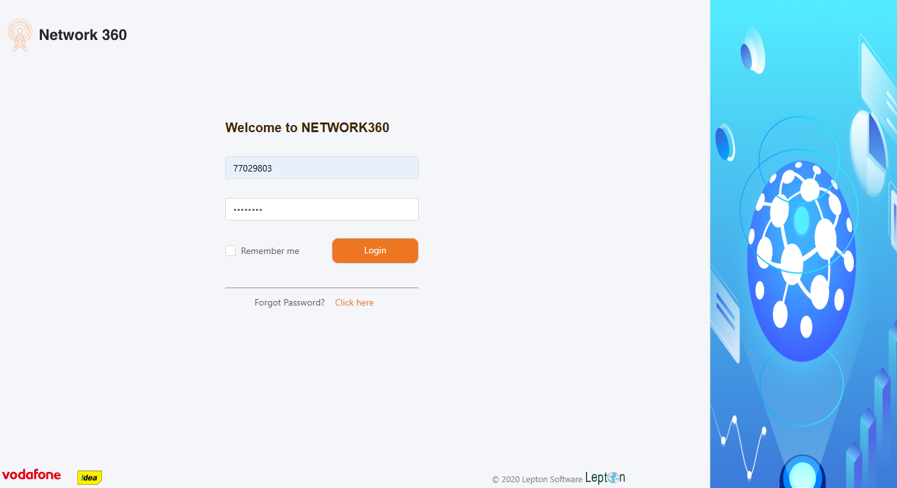
Login Page

Slide 4
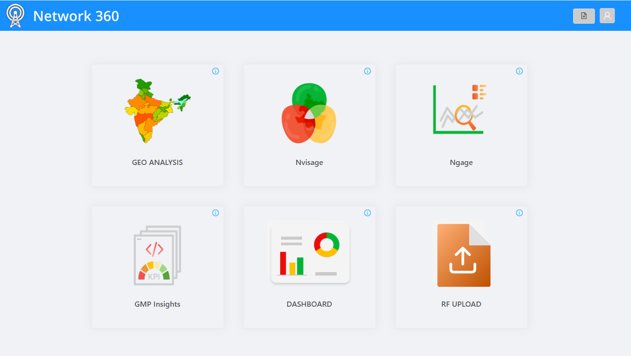
Home Page

Slide 5
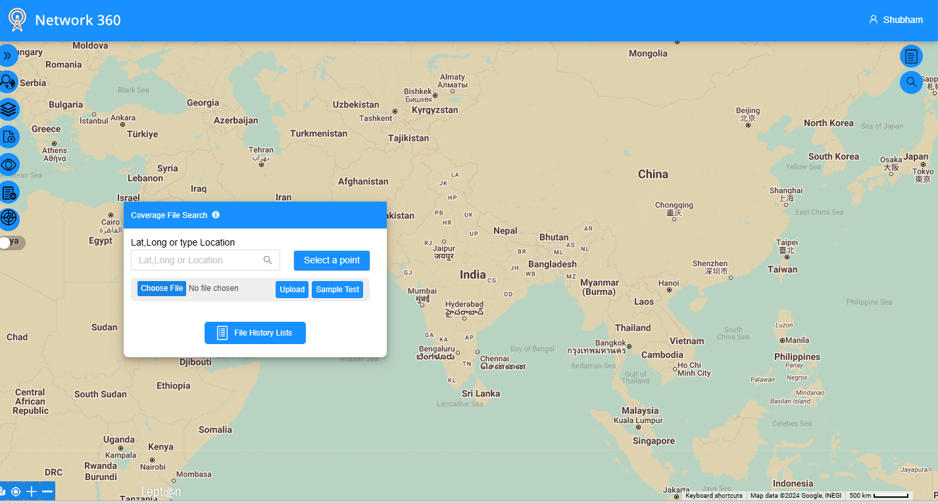
Searching Lat. Long Details

Slide 6
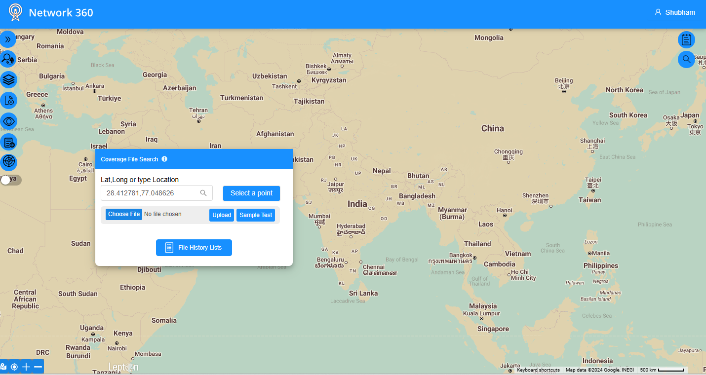
Searching Lat. Long Details

Slide 7
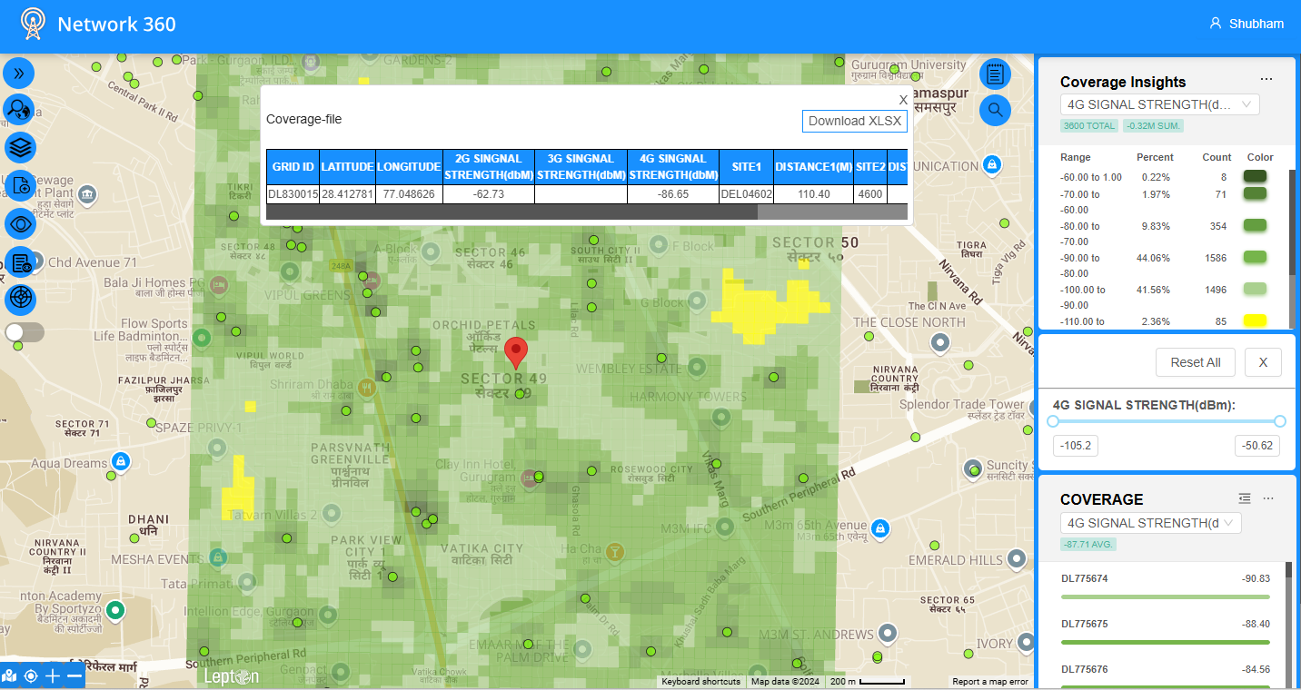
Location Details with Signal strength

Slide 8
Thank you !

